Slide 1



Scientific Calculator Project
Dolly Mishra - Software Developer Organization Name - Nexthikes IT Solutions
Role
Designed and implemented a scientific calculator using Python's Tkinter library.
Skills
Demonstrated advanced GUI development, event handling, and function-based programming.
Goal
Create a user-friendly and visually appealing calculator with extended functionality.
Notes:
Welcome to my project on a Scientific Calculator built using Python. I am [Your Name], a software developer with a focus on creating user-centric applications. This project allowed me to apply my programming skills to a practical and visually engaging tool.
The aim was to develop a fully functional calculator that could perform not only basic arithmetic but also advanced scientific operations. By leveraging Tkinter, Python’s standard GUI library, I structured a robust application that integrates mathematical libraries and dynamic event handling.
This introduction lays the groundwork for the detailed exploration of features, challenges, and insights that shaped the project.

Slide 2
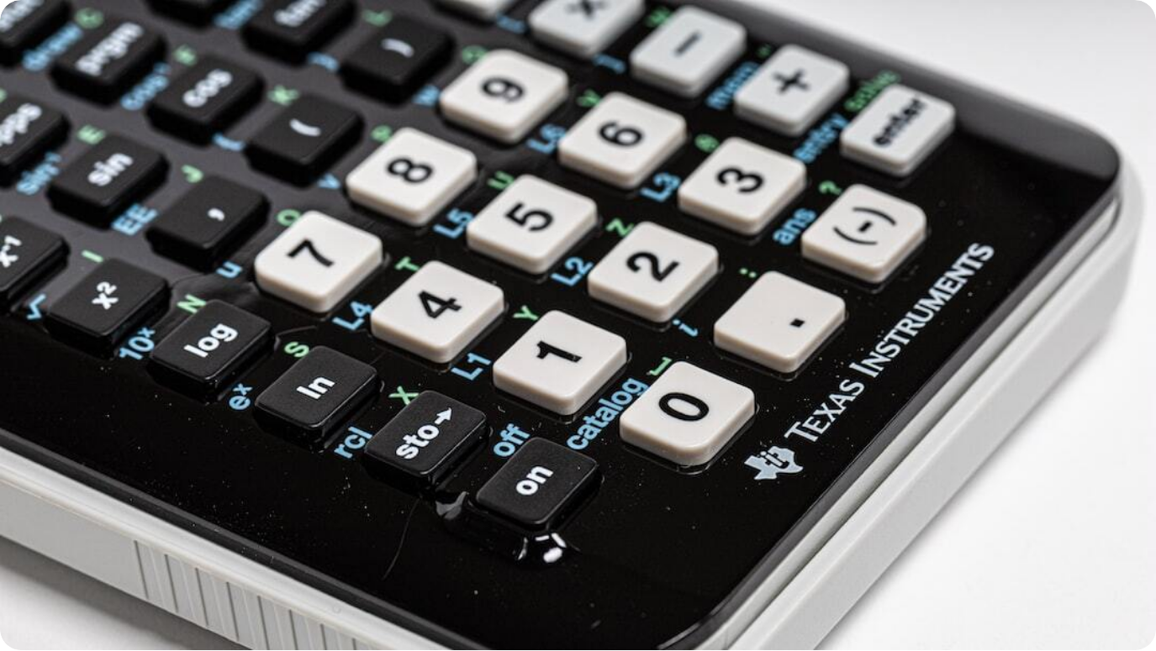
Calculator Overview & Features
Functional, Advanced, and User Benefits
Introduction: A Tkinter-based GUI calculator supporting arithmetic, scientific functions, and visual design enhancements.
Core Features: Includes basic arithmetic, CE, backspace, bracket handling, decimal support, and real-time evaluation.
Advanced Features: Integrates math functions: log, ln, sqrt, π, e, factorial, power, exponential, modulus, reciprocal.
Helpful Aspects: Intuitive layout, memory store/retrieve (MC-/MC+), error handling, and elegant button design for usability.
Photo by Ray Reyes on Unsplash
Notes:
This slide details the core functionality and the specialized features of the scientific calculator.
The calculator isn’t just about numbers – it integrates usability and precision. Built using Tkinter, its GUI is designed for both aesthetics and functionality, offering a clean, responsive user interface. The interface includes a wide array of buttons configured for standard operations and scientific needs.
Advanced capabilities such as logarithmic functions, exponential evaluation, square roots, and constants like π and e enhance its practicality for academic or professional use. Beyond operations, features like memory management (MC+/MC-) and clean error handling make it robust for users across levels.

Slide 3




Libraries & Development Challenges
Technical Stack and Problem-Solving Journey
Python Libraries
Utilized Tkinter for GUI, Math for scientific operations like factorial, log, sqrt, and exponential functions.
Design Challenges
Aligning button grid, ensuring dynamic layout scaling, and tried to manage widget responsiveness in Tkinter.
Error Handling
Preventing runtime crashes with invalid input, exceptions for math domain errors and UI lockups.
Solution Strategies
Implemented structured function parsing, memory variables, modularized logic.
Notes:
This slide delves into the backbone libraries and the development hurdles I faced during the creation of the calculator.
Tkinter provided a flexible and powerful toolkit for building the GUI, while Python’s math module brought in scientific computation capabilities. These libraries formed the technical foundation of the project, enabling rapid prototyping and feature expansion.
The development journey was not without challenges. Aligning buttons neatly within the GUI and maintaining layout consistency was tricky. Exception handling had to be robust to catch edge cases like invalid inputs or non-integer factorials. I tackled these issues by refining the expression parsing logic, implementing error checks, and keeping the code modular for easier updates and debugging.

Slide 4
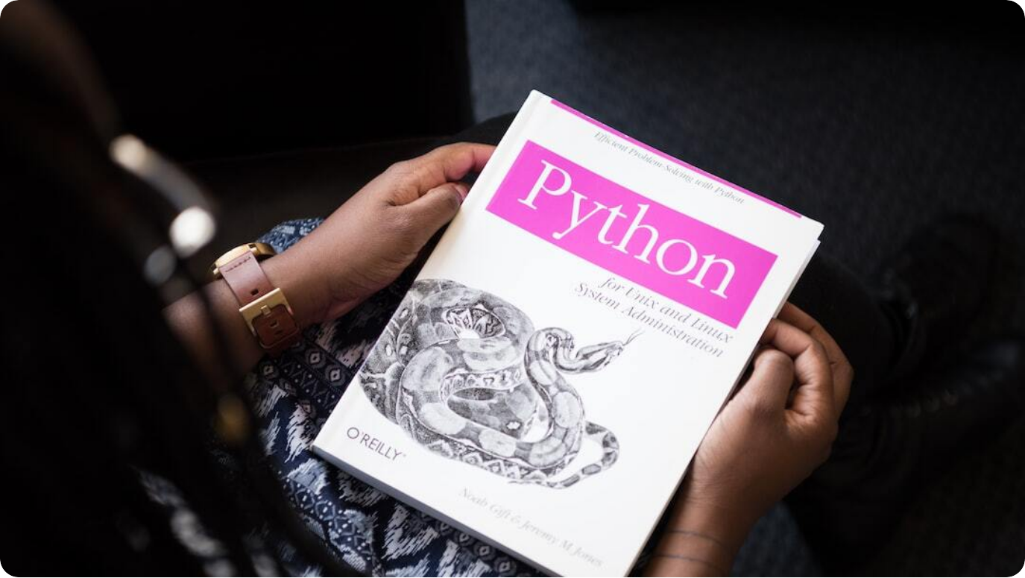
References and Learning Resources
Tools and Sources That Guided the Project
Tkinter Documentation: Used the official Python Tkinter library docs for layout and widget configuration guidance.
Stack Overflow: Resolved specific issues like button behavior, Ampercent Issue in executing code and expression parsing through expert forums.
GeeksforGeeks & TutorialsPoint: Followed tutorials to understand scientific calculator logic and event-driven design.
YouTube Python Channels: Watched video walkthroughs of GUI calculators to visualize interaction and polish UI.
Photo by Christina @ wocintechchat.com on Unsplash
Notes:
This project wouldn't have been possible without a variety of learning materials and community support. As with many coding efforts, documentation and open-source forums proved essential.
I primarily relied on the official Python Tkinter documentation to understand how to manage GUI components and events. Stack Overflow played a pivotal role in debugging issues, from handling edge cases in button clicks to complex expression evaluation.
Web tutorials from GeeksforGeeks and TutorialsPoint helped structure the logic behind scientific features, while YouTube channels provided dynamic demonstrations that helped refine the UI and user flow. These references collectively enabled faster learning and implementation.

Slide 5

Thank You!
Appreciate Your Time and Attention
Gratitude
Thank you for exploring my scientific calculator project and the learning journey behind it.
Notes:
Thank you for taking the time to go through my presentation on the Scientific Calculator project.
This endeavor not only sharpened my programming skills but also taught me much about user interface design, mathematical libraries, and structured problem-solving. I'm excited about the possibilities for future improvements and iterations of this tool.
I welcome any questions, suggestions, or feedback that can help make this project even more powerful and user-friendly. Your insights are invaluable, and I hope this presentation was informative and engaging.

